Slide 1
Predicting the Conditions using RNN and Semantic Relationship between texts.
Sandesh Reddy Pendyala Sindhusha Devi Parimi Z1859176 Z1855951
12/05/2019

Slide 2
Dataset
Clinical Trials Dataset
Taken from ClinicalTrials.gov Registry which is a resource provided by the U.S. National Library of Medicine.
Objective:
To predict the disease/condition given the Title by using a model based on RNN and another model using USE.

Slide 3
Dataset(Continued..)
Dataset consists of 32729 rows and 57 columns/attributes.
Feature Selection : Title
Class Label : Condition

Slide 4
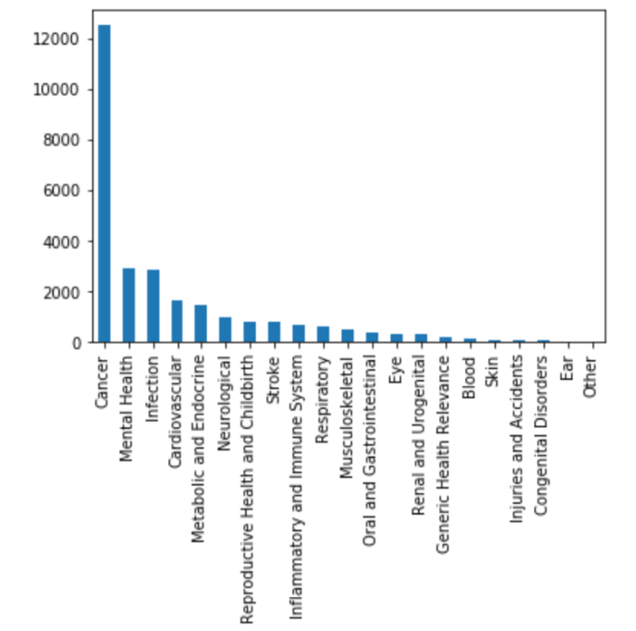
Distribution of Conditions

Slide 5
Tools and Libraries
Sklearn(Splitting data into train,test)
fastai
tensorflow
Keras
Universal Sentence Encoder
Seaborn(for Visualization)

Slide 6
Text Classification Model
ULMFiT from fast.ai – classify text using language modelling and transfer learning.
The ULMFiT model uses multiple LSTM layers
Steps:
Import the Data
Create train & validation datasets and FastAI data bunch
Create and Train the Language Model
Using the Language Model to Train the Classifier
Predictions

Slide 7
FastAI provides two functions TextLMDataBunch, which creates data bunch for language modelling and TextClasDataBunch, which creates data bunch for classification.

Slide 8
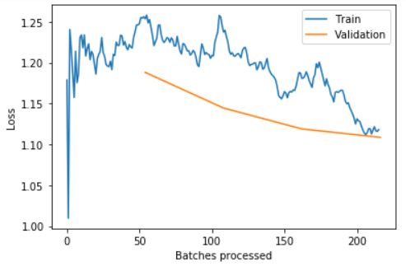
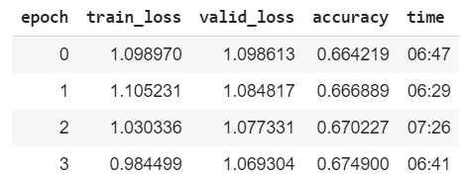
Loss and Accuracy

Slide 9
Universal Sentence Encoder
Vectorizes any given text input into a vector of dimension 512
Vectors are encoded such that the vectors are closer to each other based on their semantic meaning rather than just the Euclidean distance.

Slide 10
Example:
Consider the three sentences below.
How old are you?
What is your age?
How are you?

Slide 11
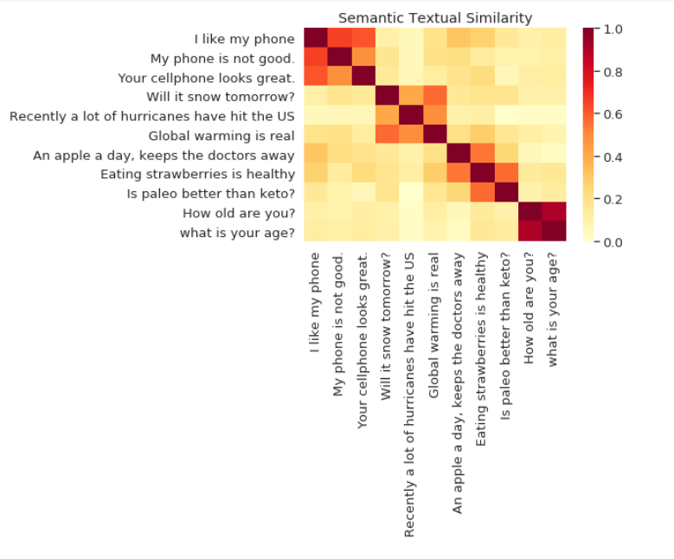

Slide 12
Data Processing
Modify the data in such a way that all the classes are present in both train and testing data sets.
This meant removing those classes which are too few to be split evenly after stratifying the data set.
1-Hot encoding for the classes after the train and test split.

Slide 13
Model Building
Once the data is ready, we can now pass it onto USE’s embedder which vectorizes it.
This vector is then passed onto the model which takes it as an input while training.
Used Softmax activation function since the classes are categorical

Slide 14
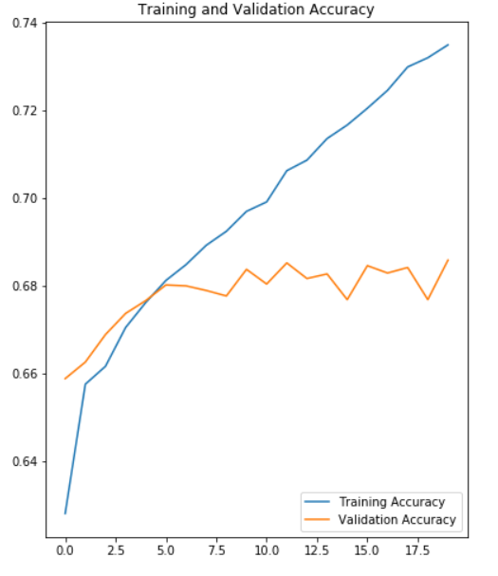
Results
This model resulted in a training accuracy of 74% while the validation accuracy had plateaued at 68%

Slide 15
Conclusion
Low accuracy because of severe imbalance in data.
Future Work:
Increase the training duration.
Fix imbalance with oversampling of minority classes

